Slide 1




Great Outdoors Final Presentation
z
By: Amit Yadav (Manager)
Megha Jain
Meghana V
Rakshitha U C
Rakshith Reddy
Zulfa Syed

Slide 2
Overview
Progress Update
Screen Shots
Thank You
Flow Charts

Slide 3
Progress Update
Completed with Sign up and Sign in functionalities
Created different microservices based on requirements
Created API Gateway and Registry to integrate Microservices
Integrated with Database
Created basic APIs for application
Testing of APIs using Postman
Tested microservices integration on eureka server

Slide 4
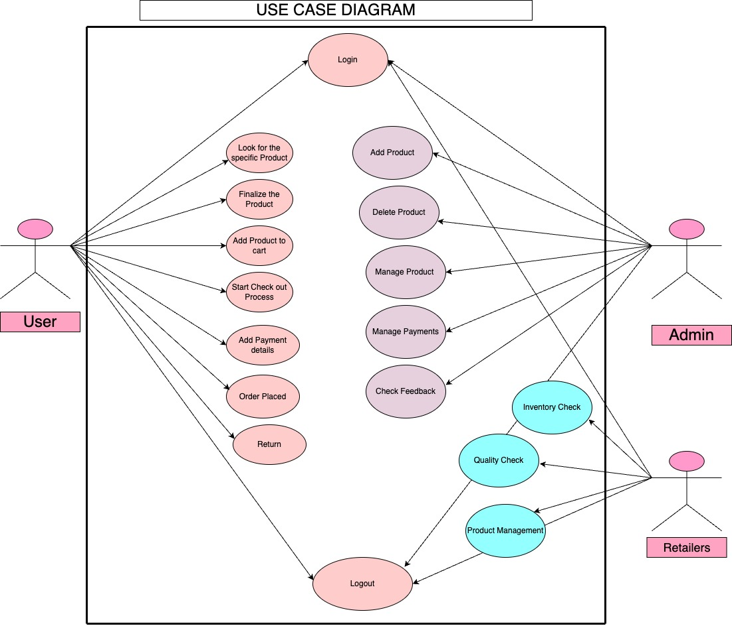

Slide 5
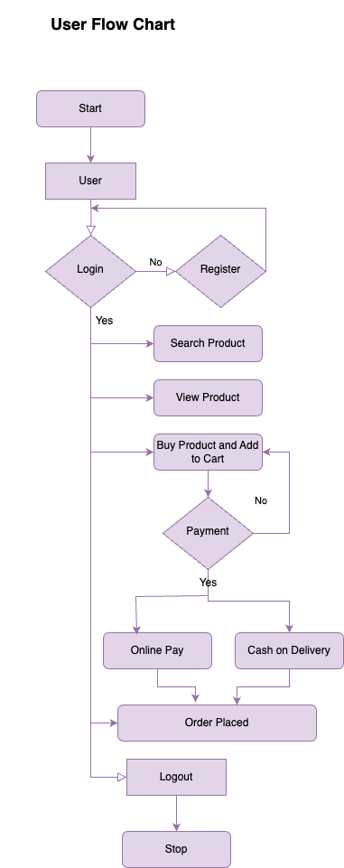
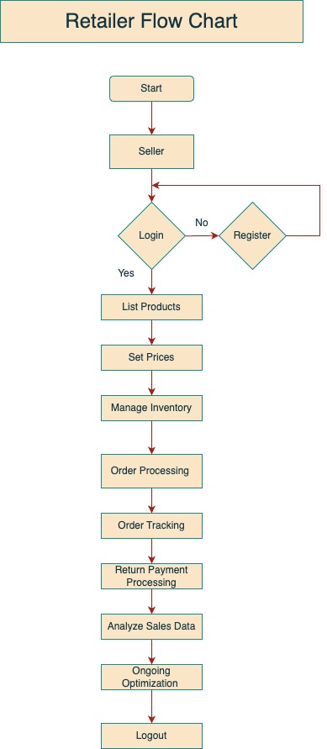
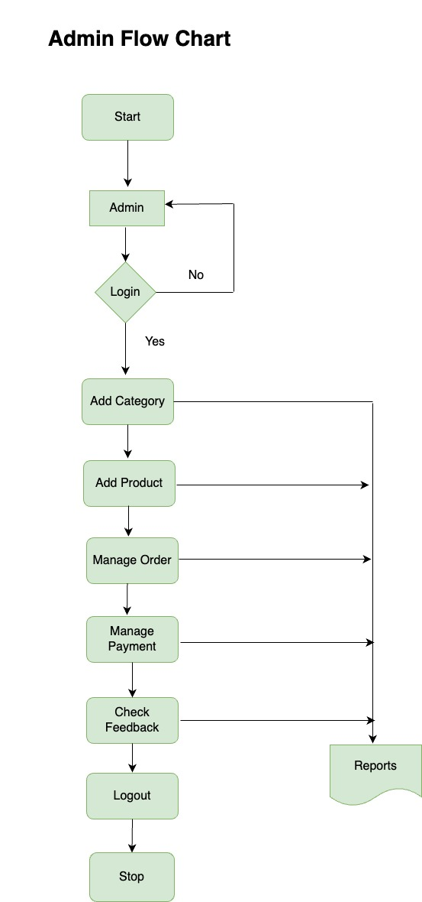

Slide 6
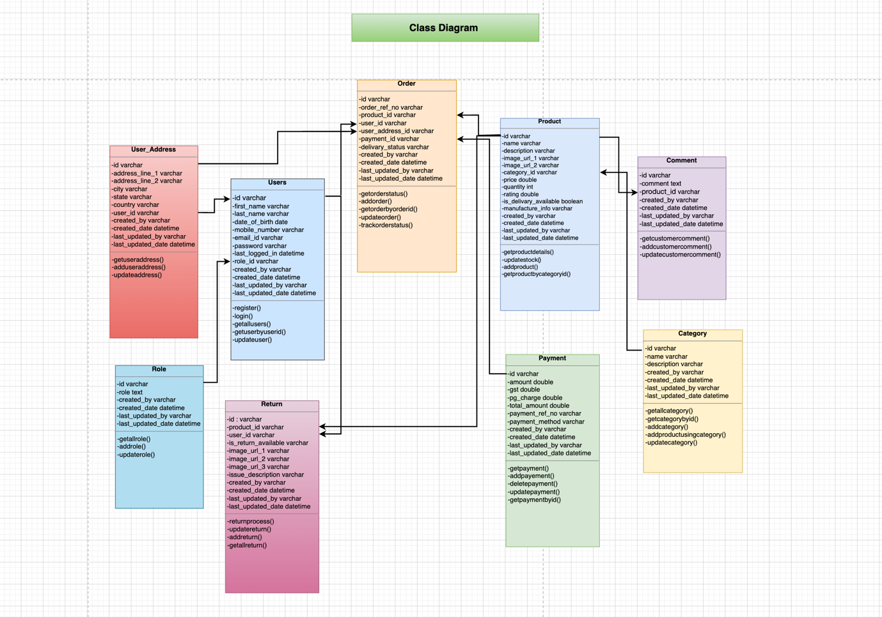

Slide 7
Overview on the project implementation
z

Slide 8
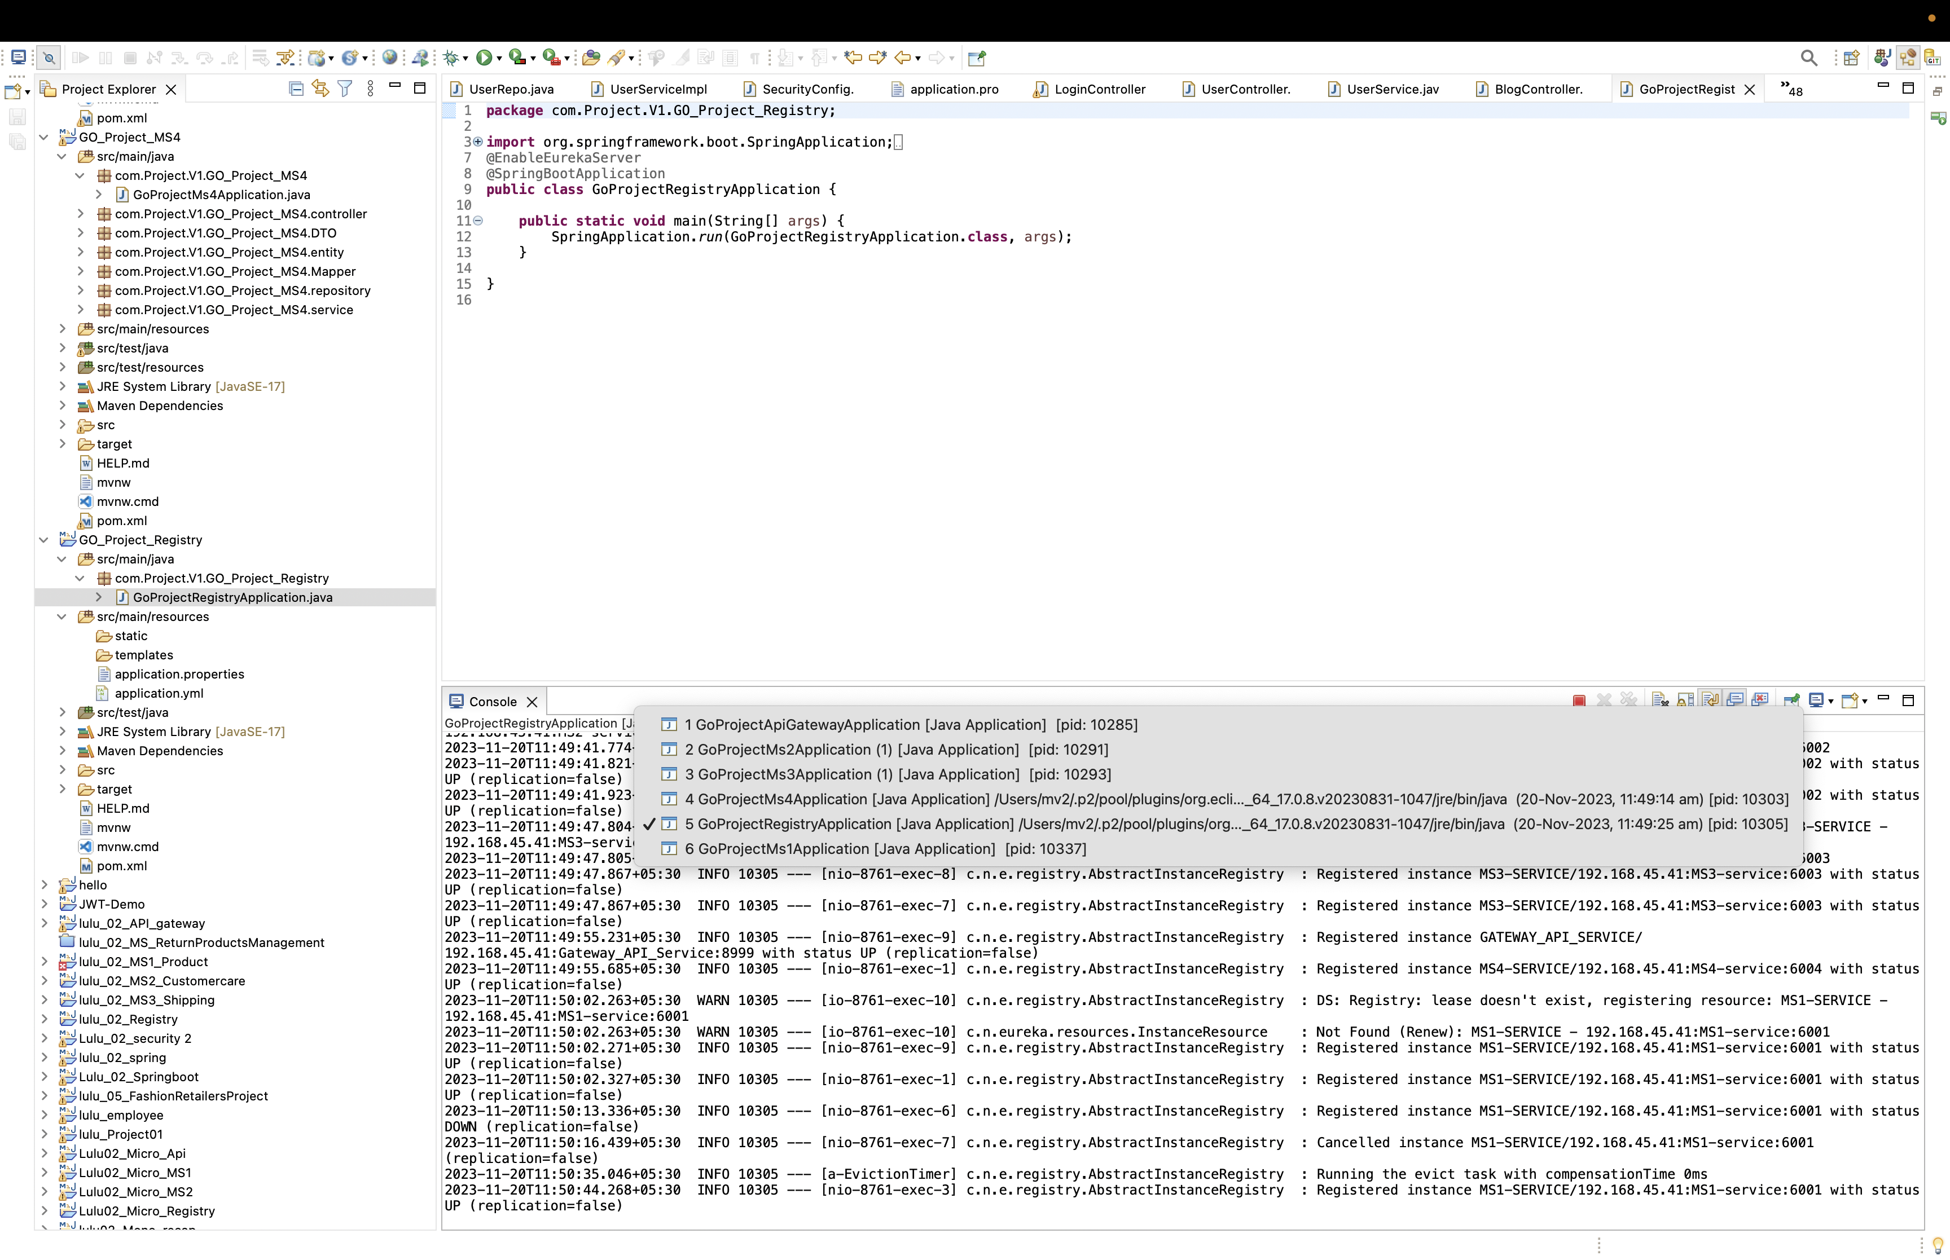
Registry Application Main class

Slide 9
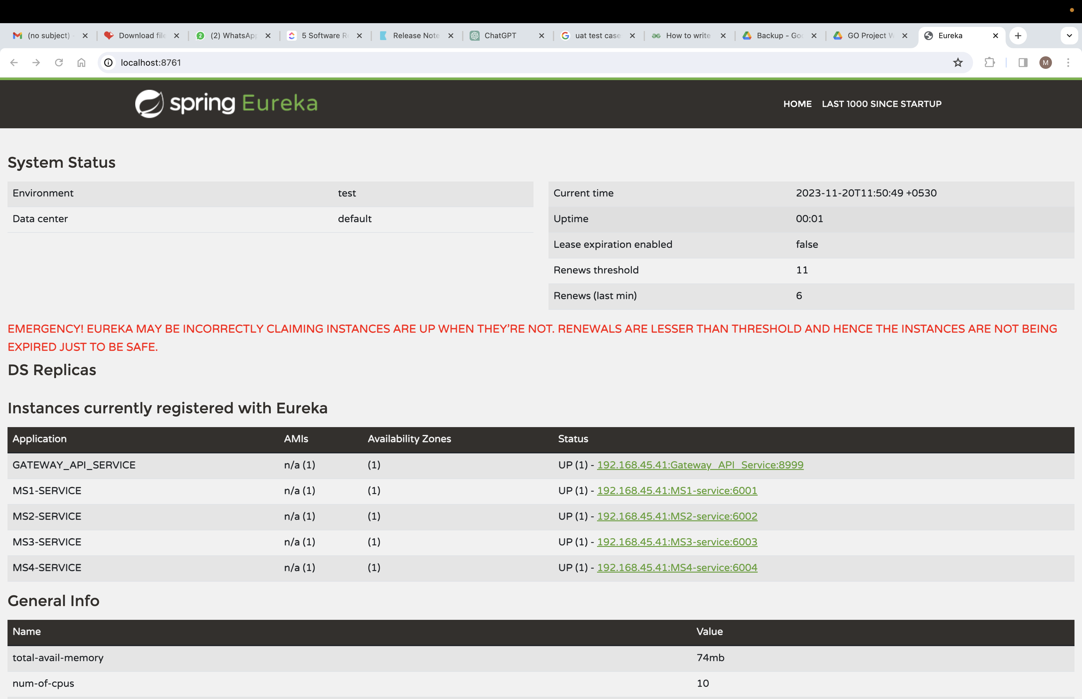
Eureka Server

Slide 10
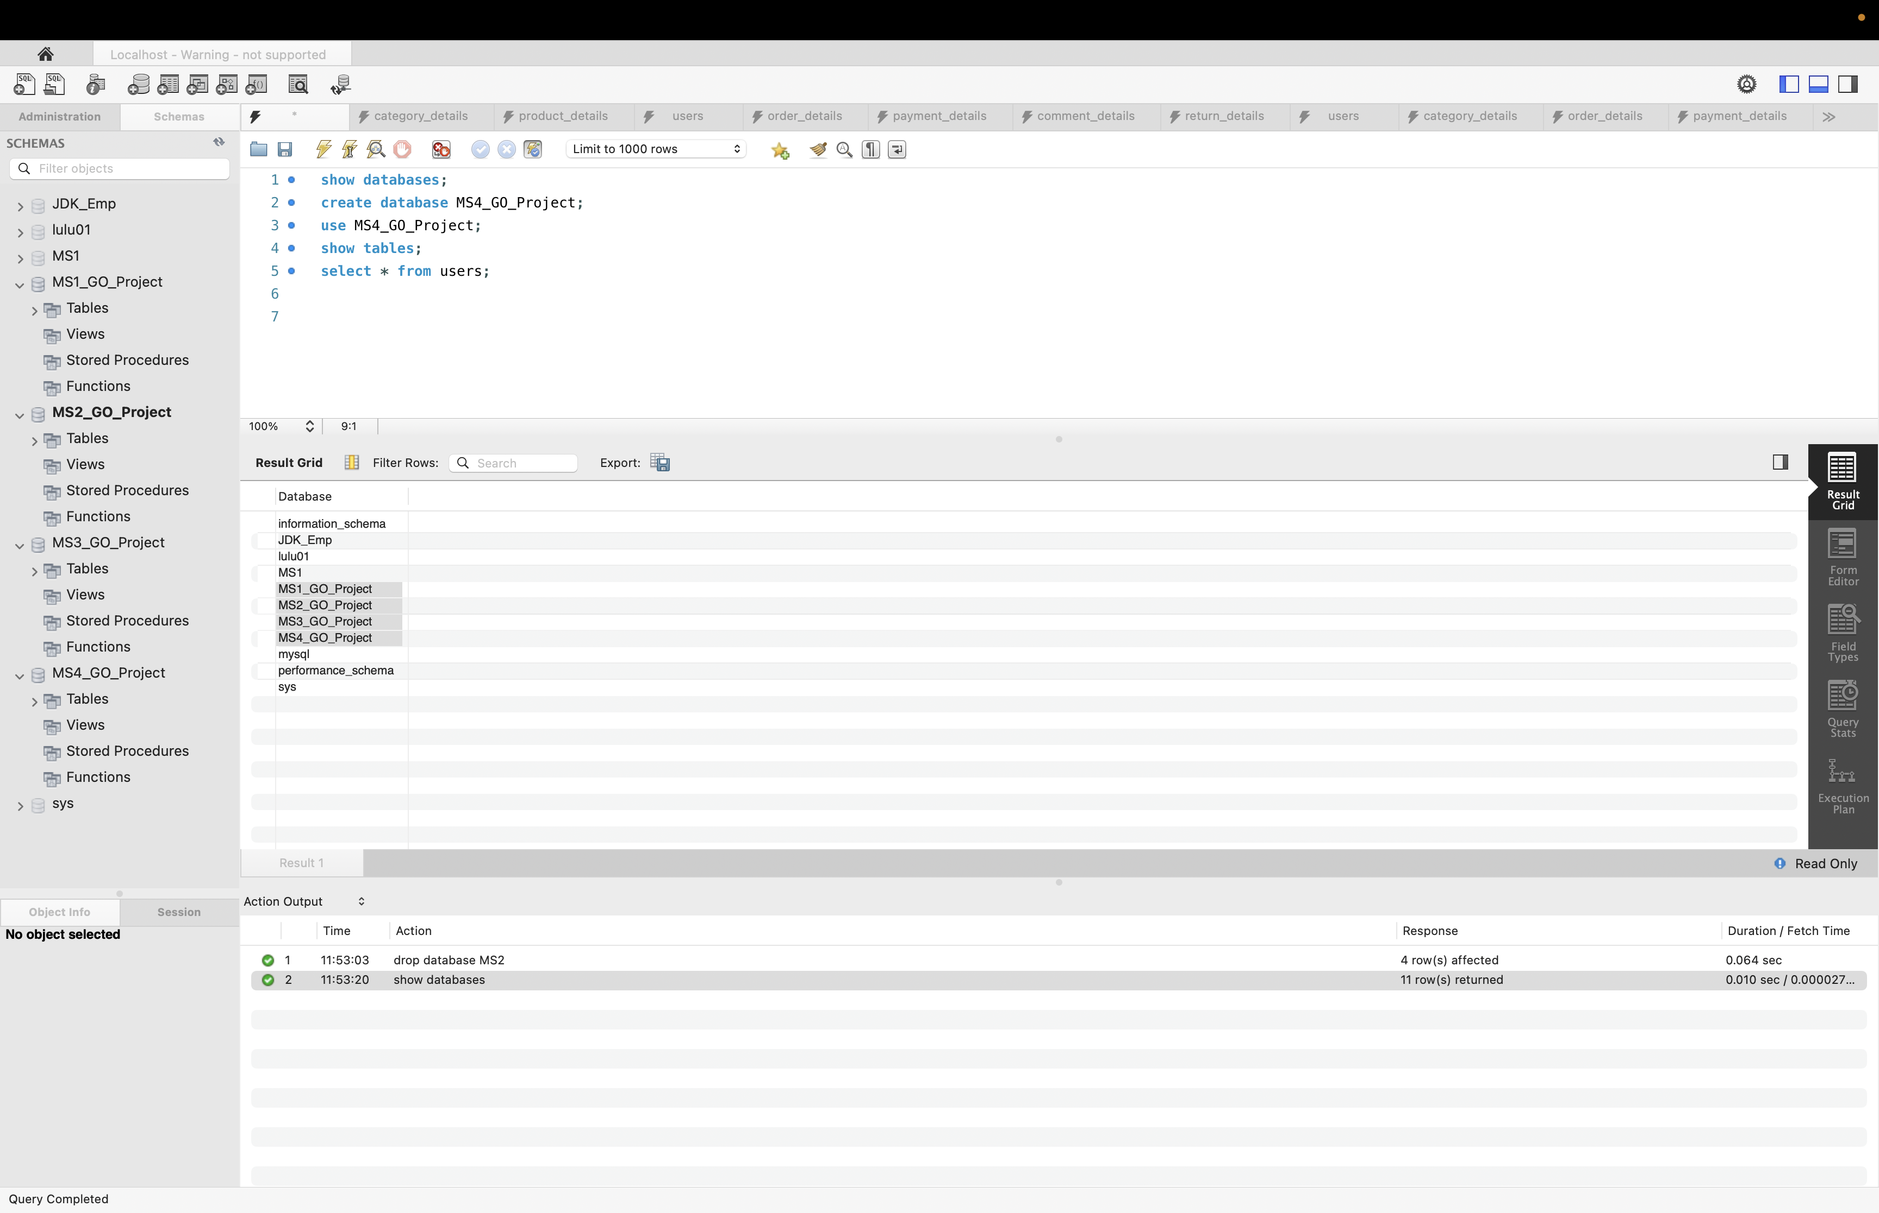
Go_Project Database

Slide 11
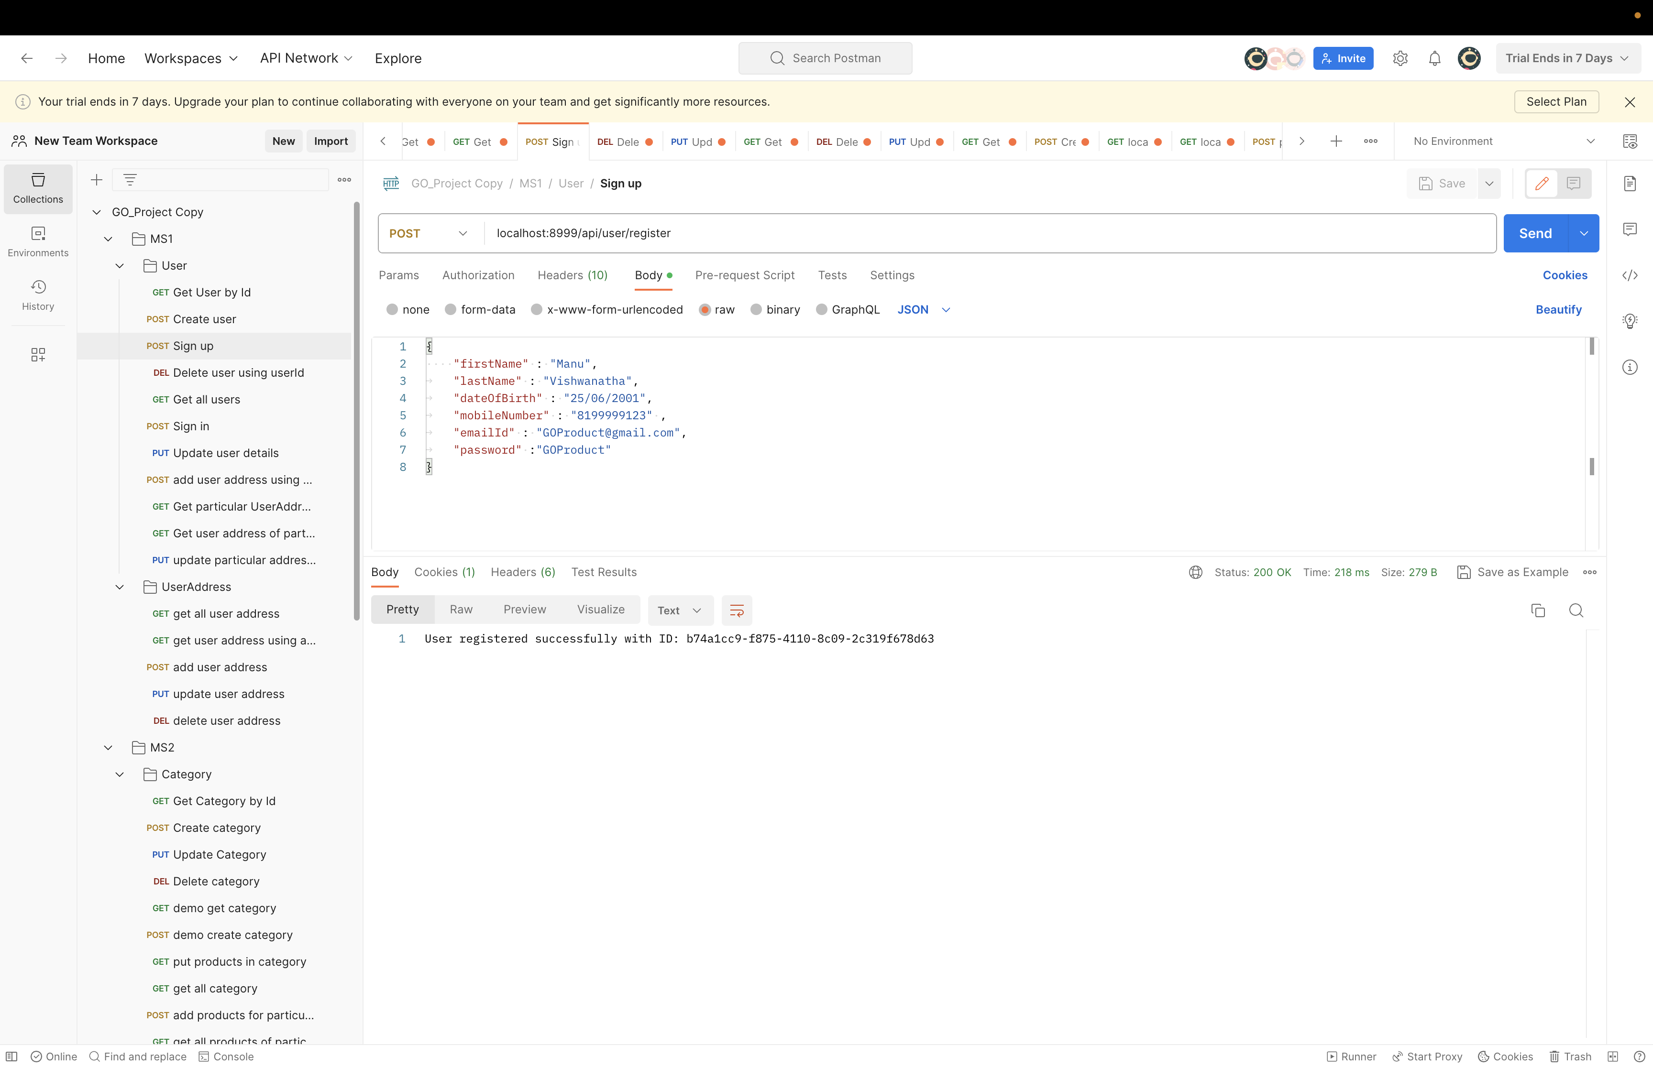
Post Operation
(User Registration )

Slide 12
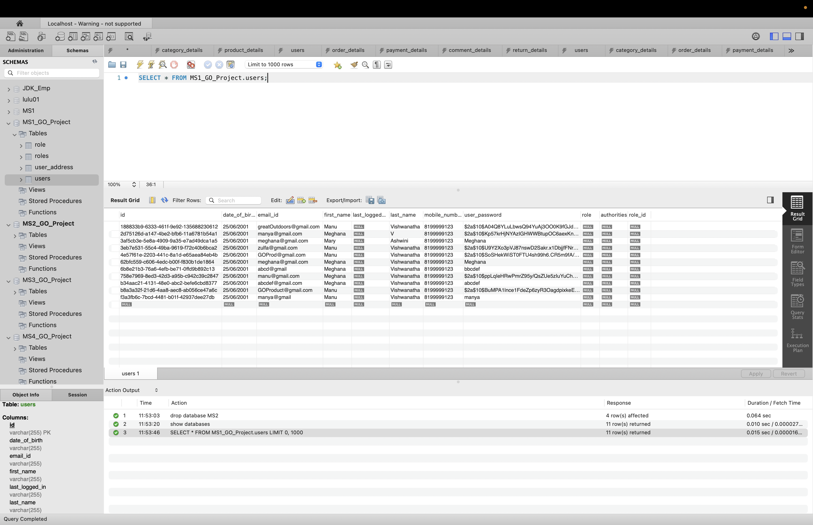
User Database

Slide 13
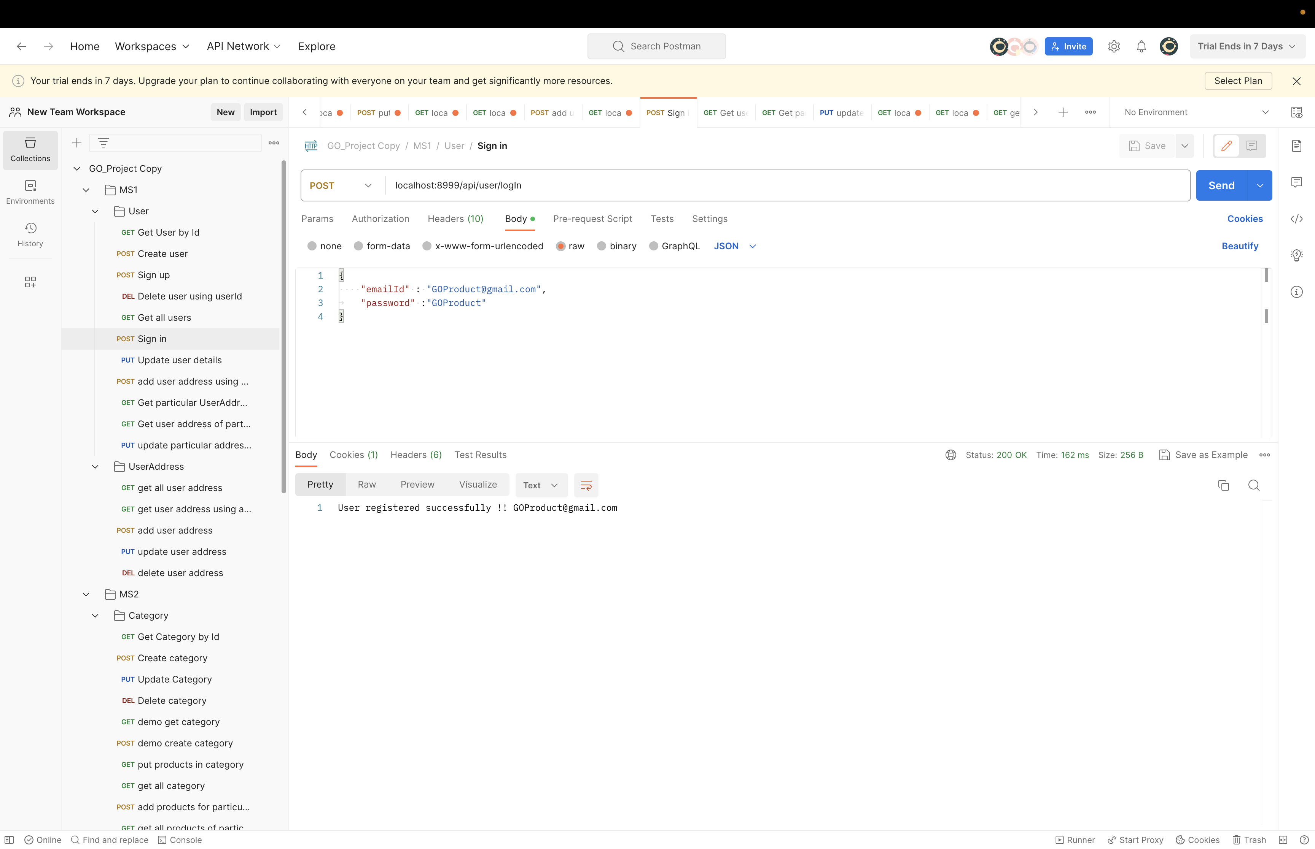
Post
Operation (User Login)

Slide 14
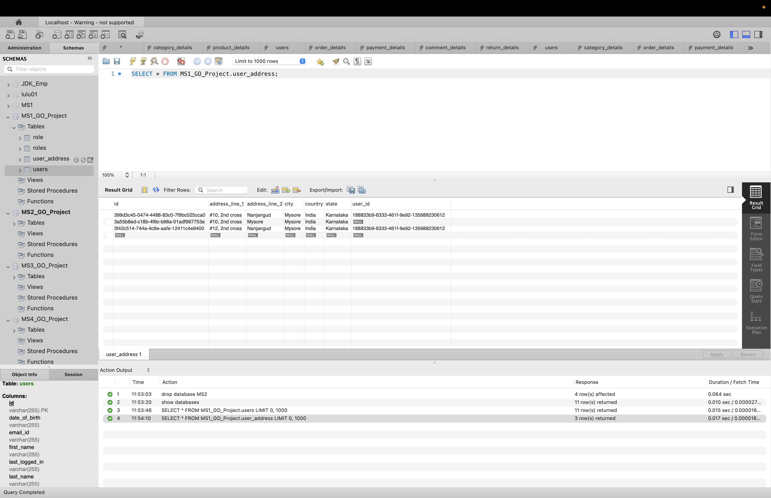
User_Address Database

Slide 15
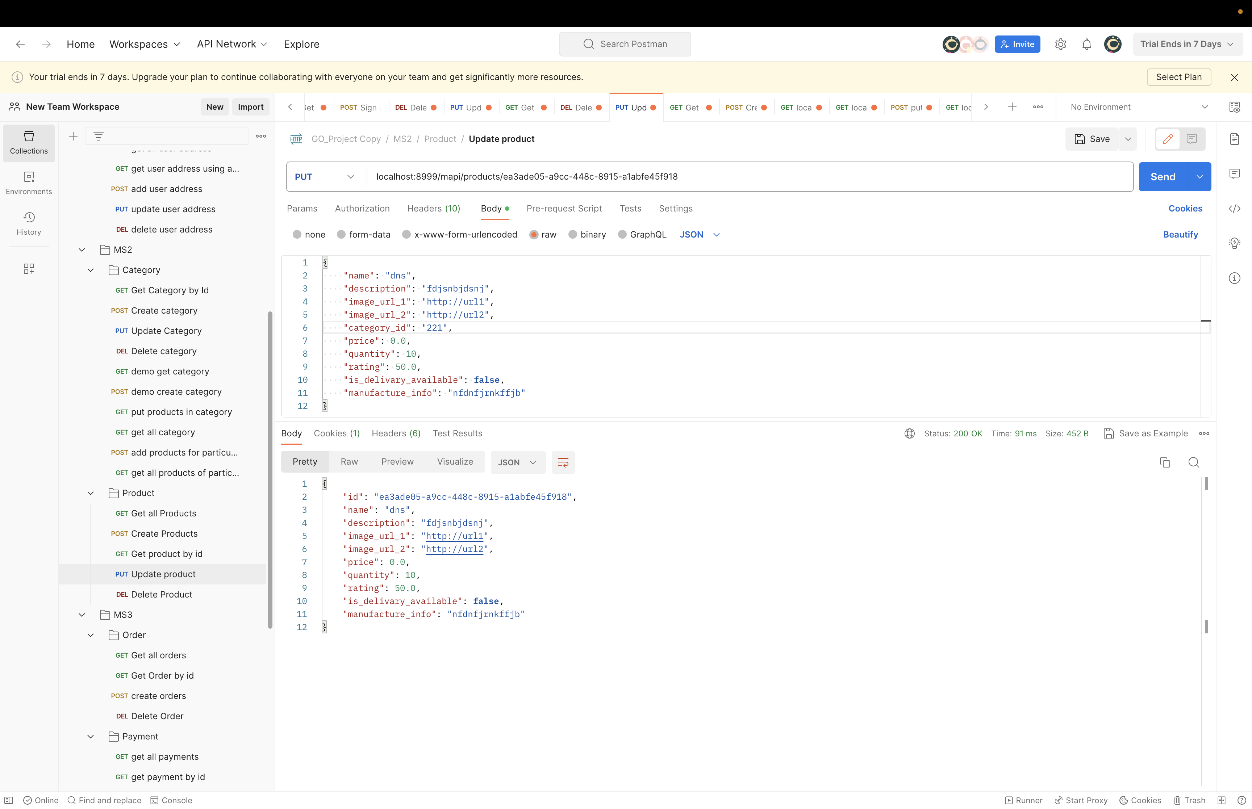
Put Operation
(Products)

Slide 16
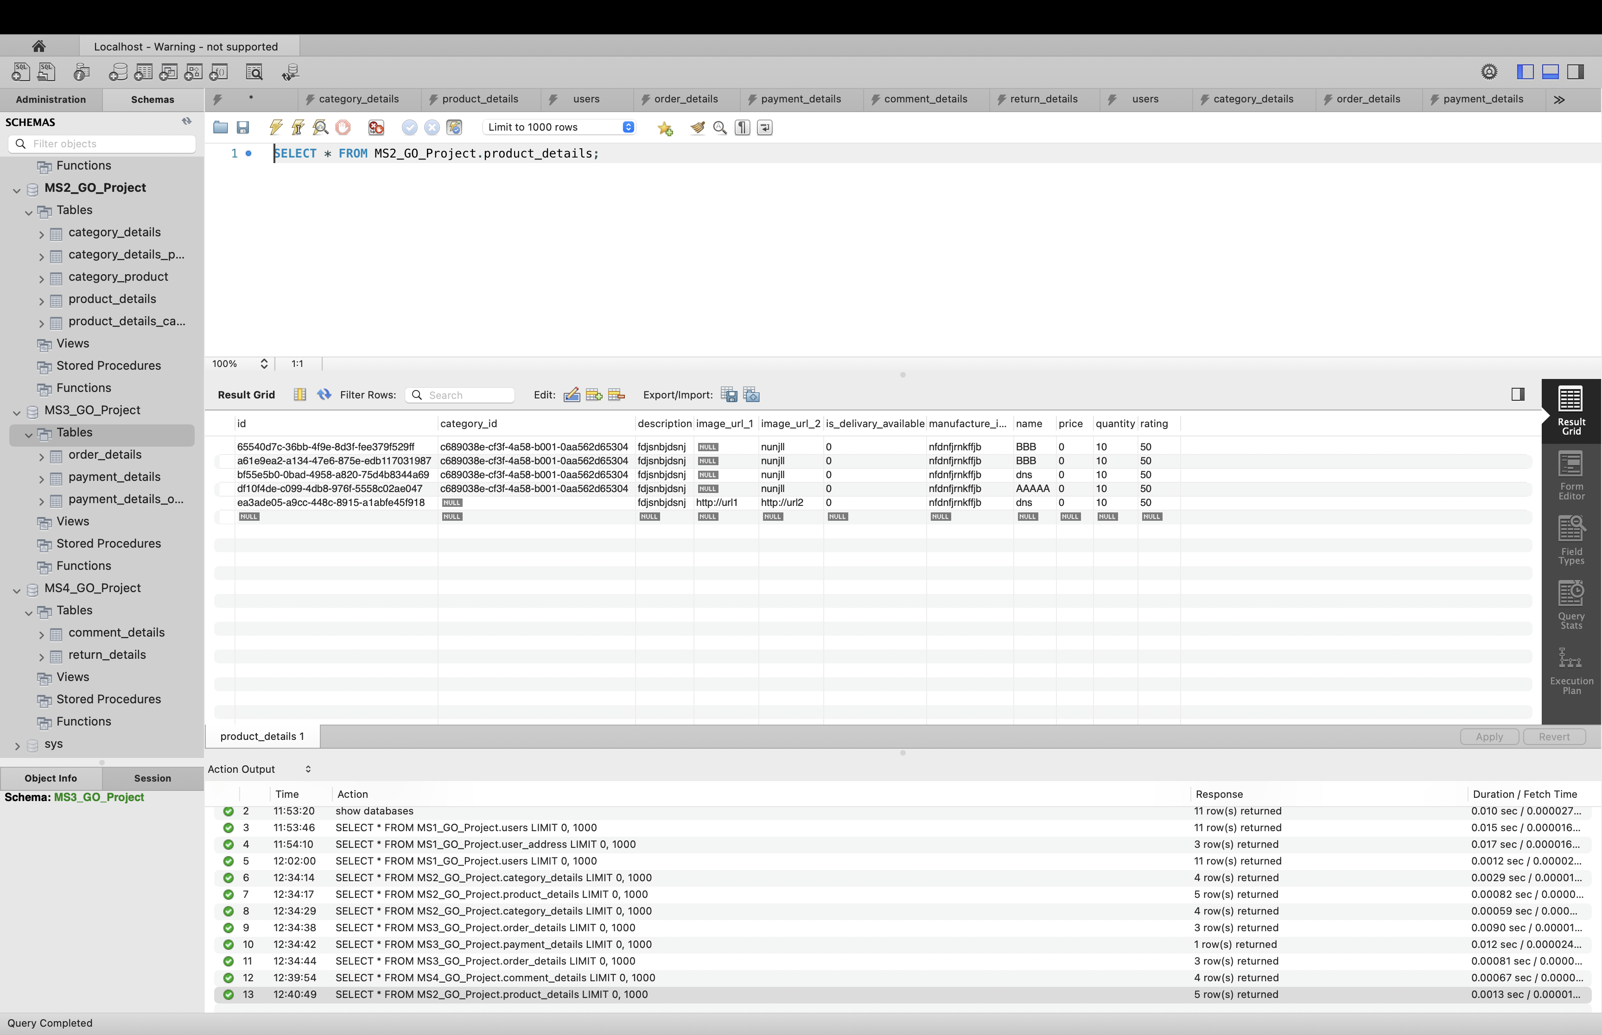
Product Database

Slide 17
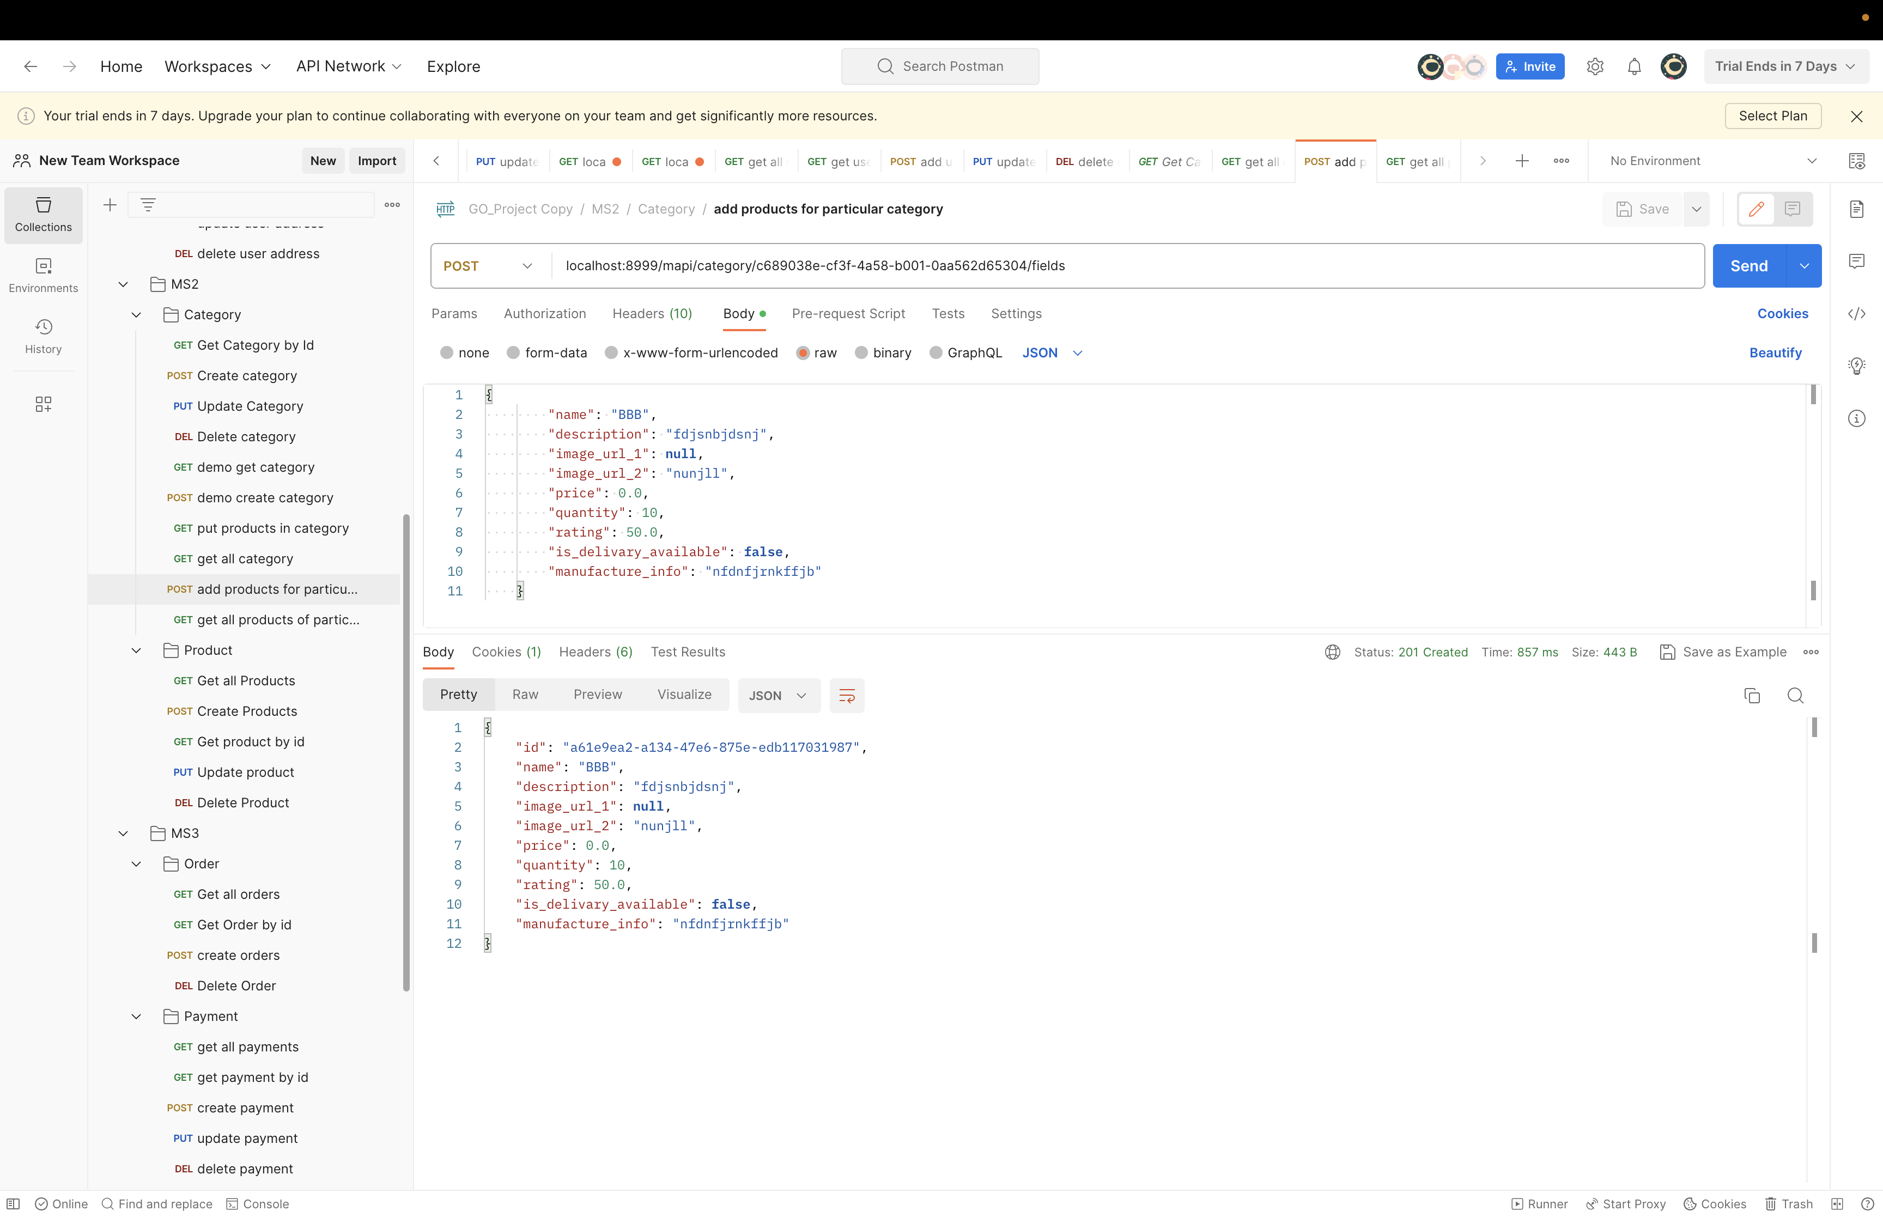
Post Operation (Category)

Slide 18
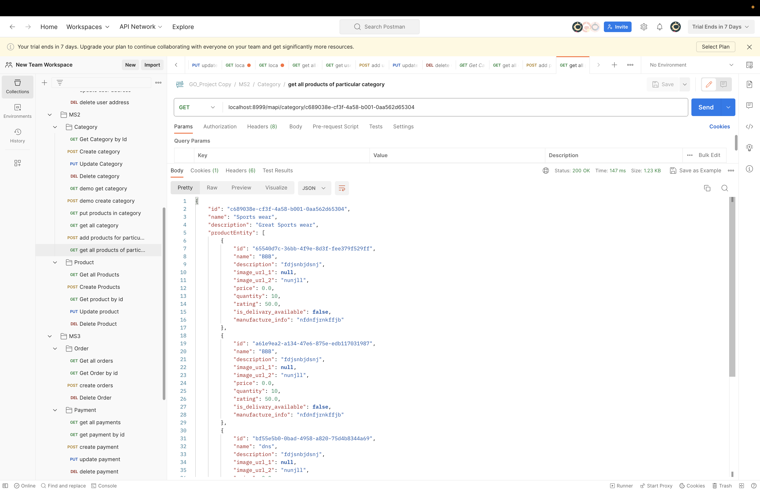
Get Operation by Category

Slide 19
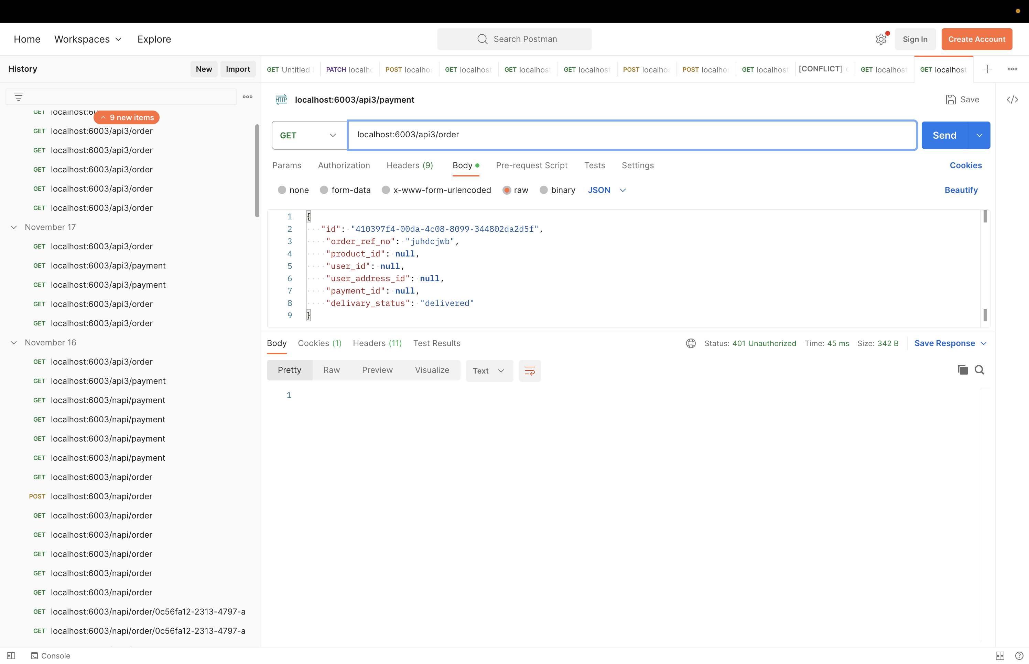
Get Operation
(Order)

Slide 20
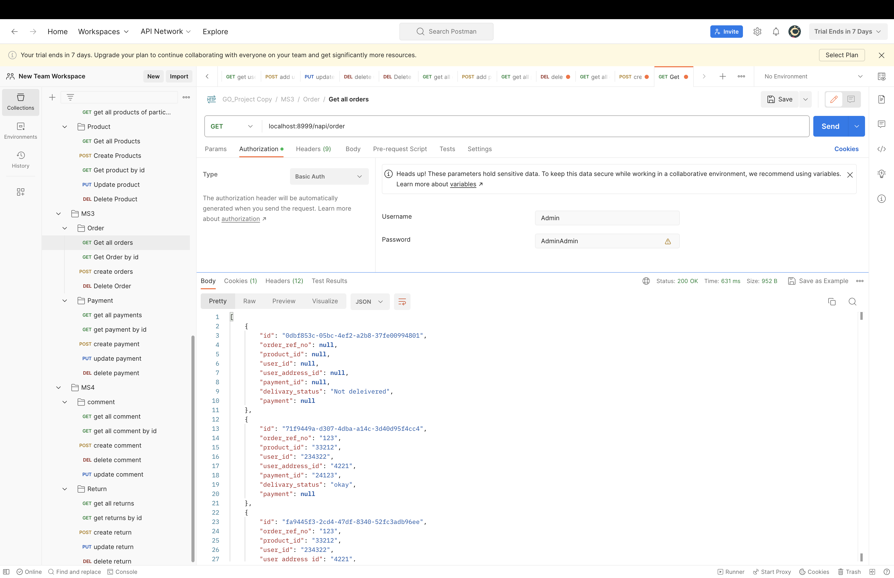
Web Security
(Order and Payment)

Slide 21
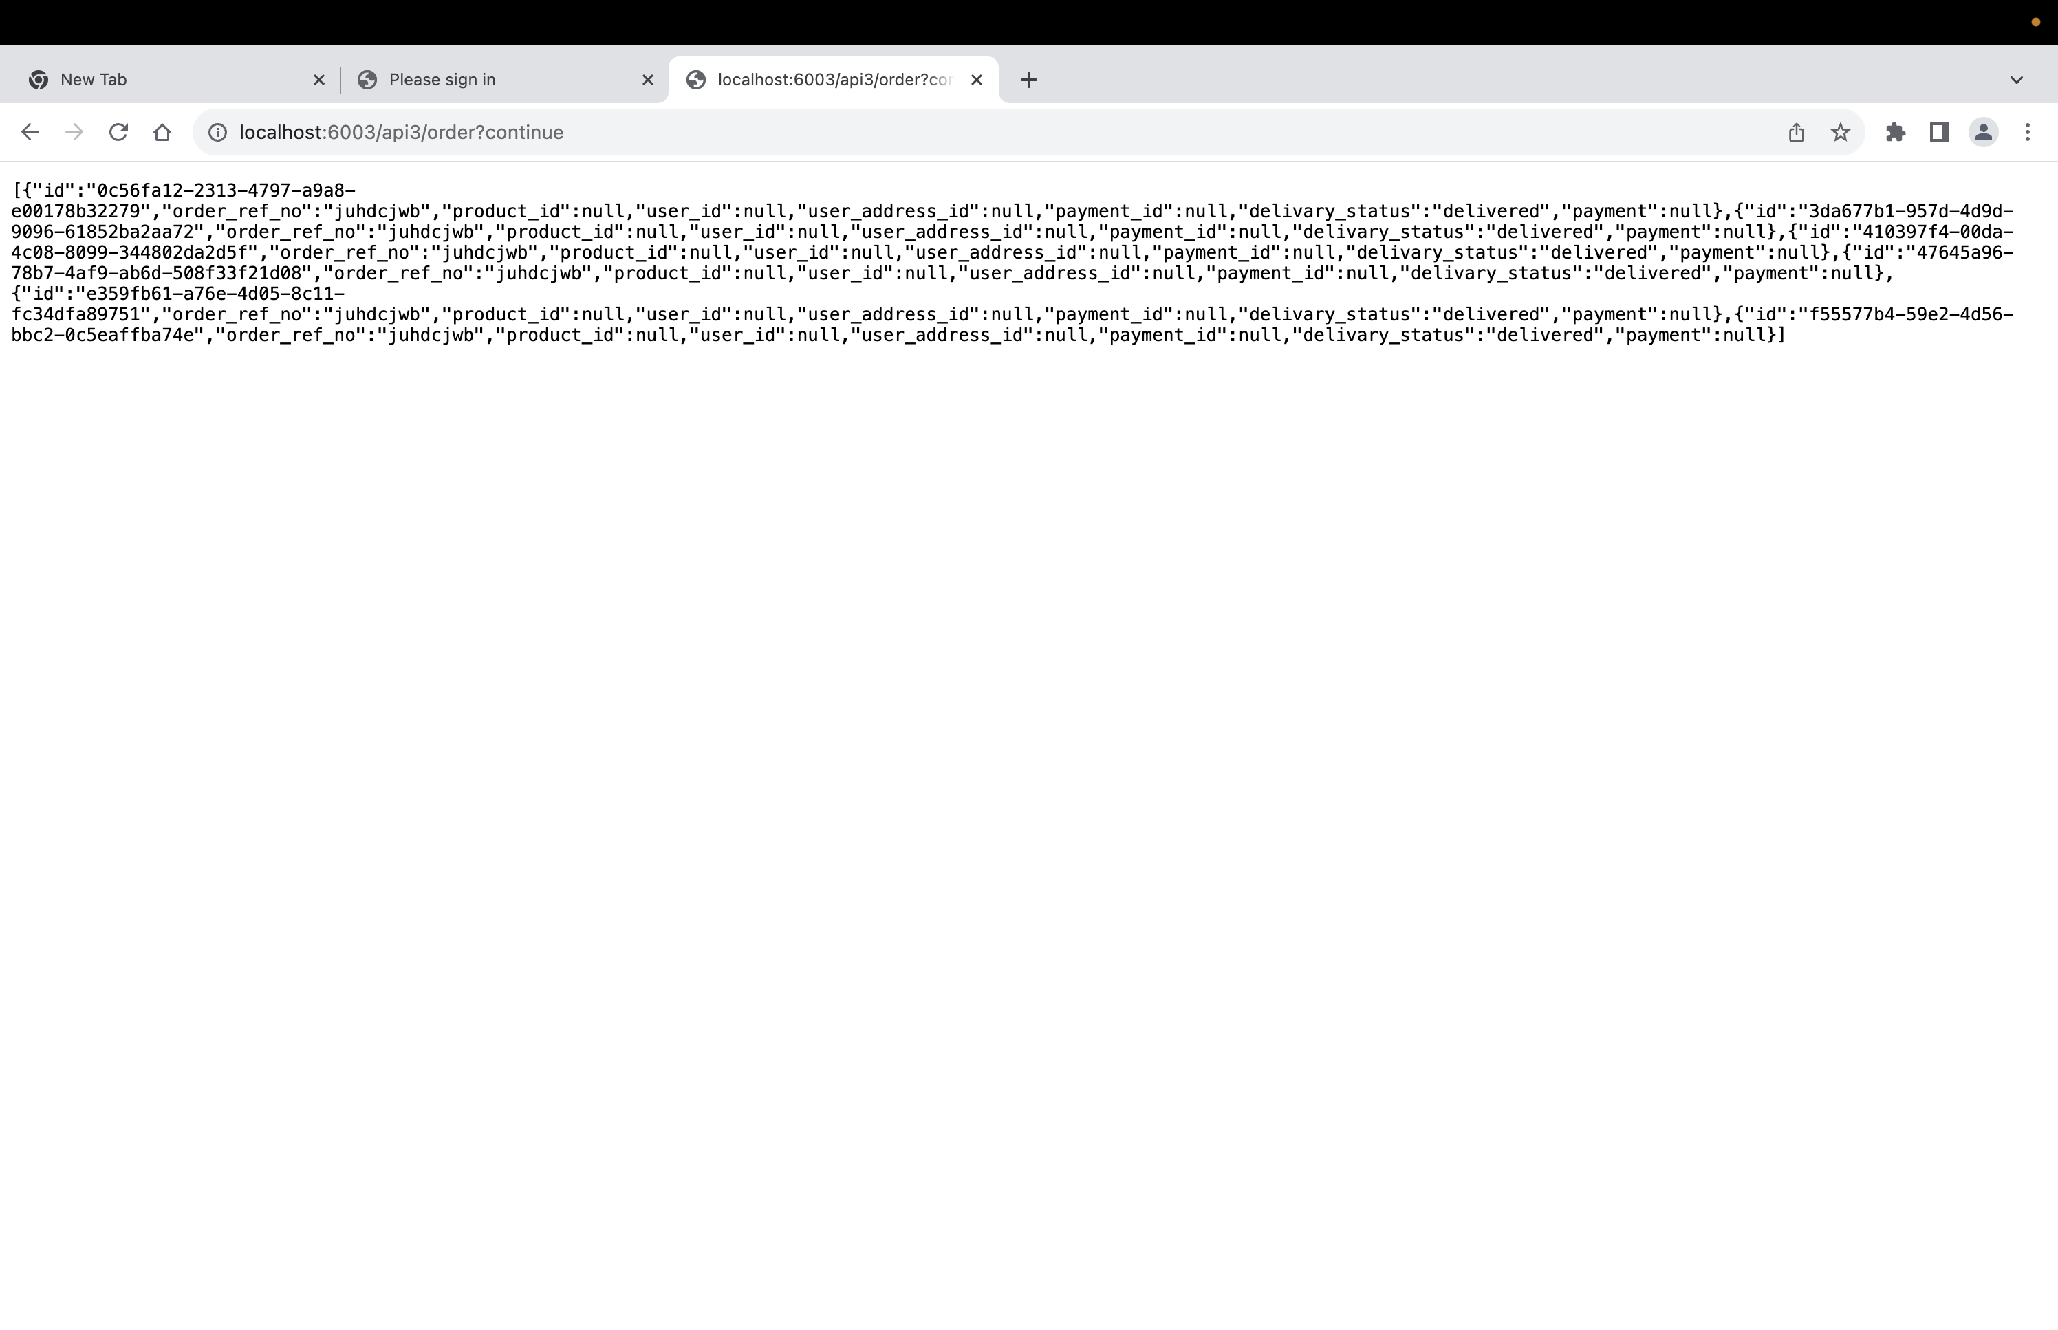
Order details in HTTP

Slide 22
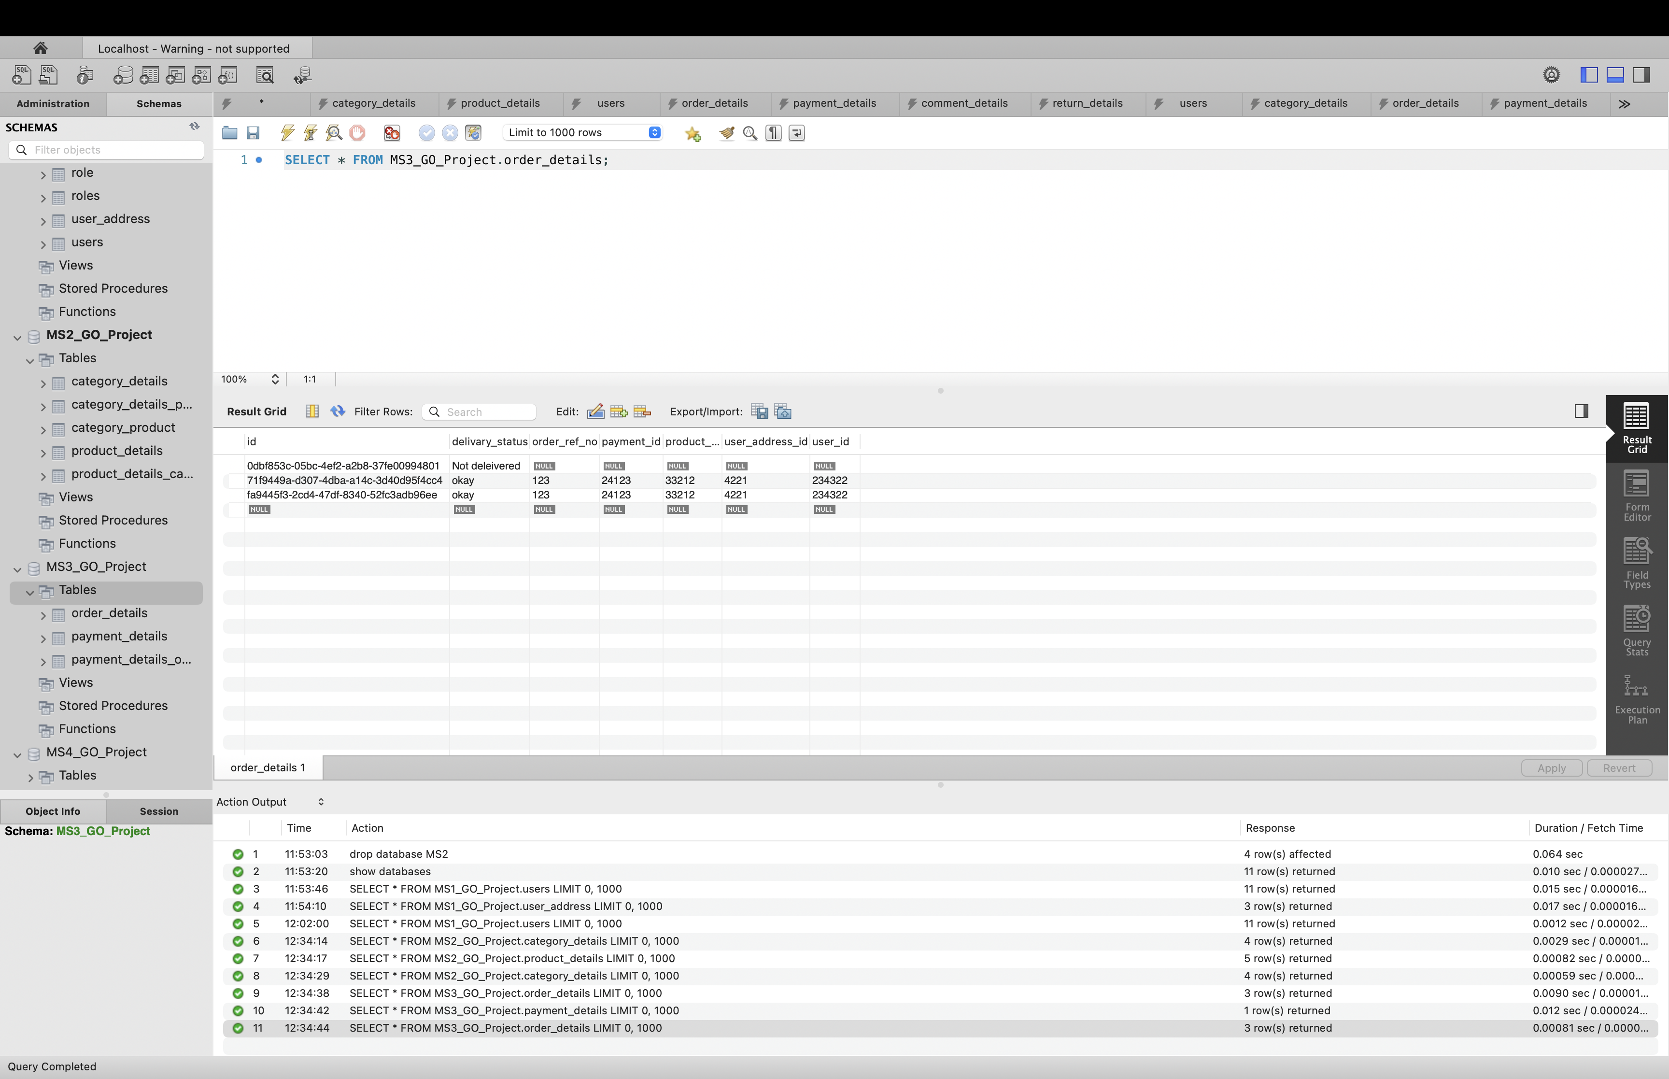
Order Database

Slide 23
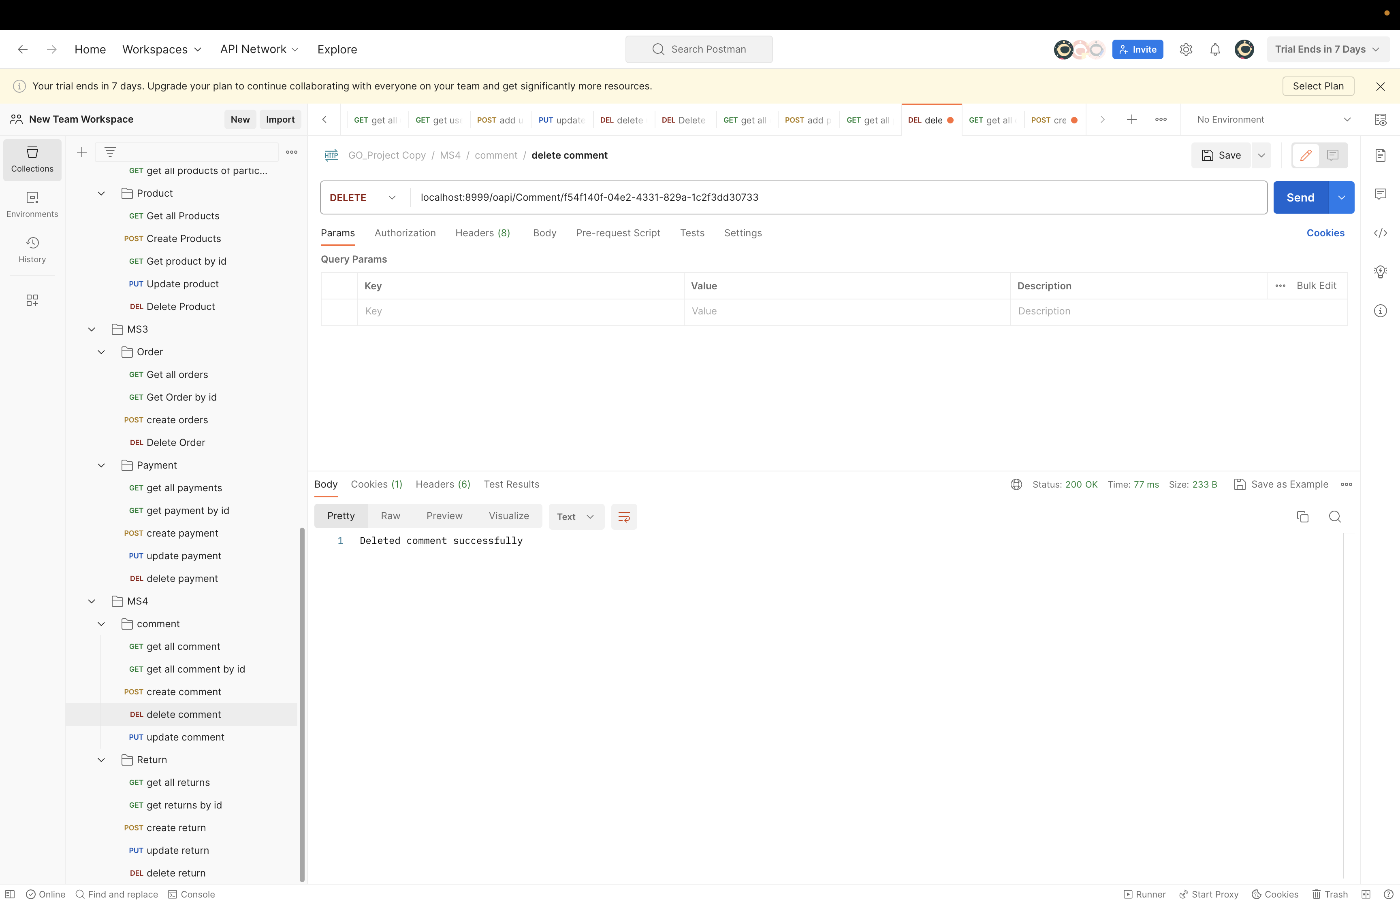
Delete Operation
(Comment)

Slide 24
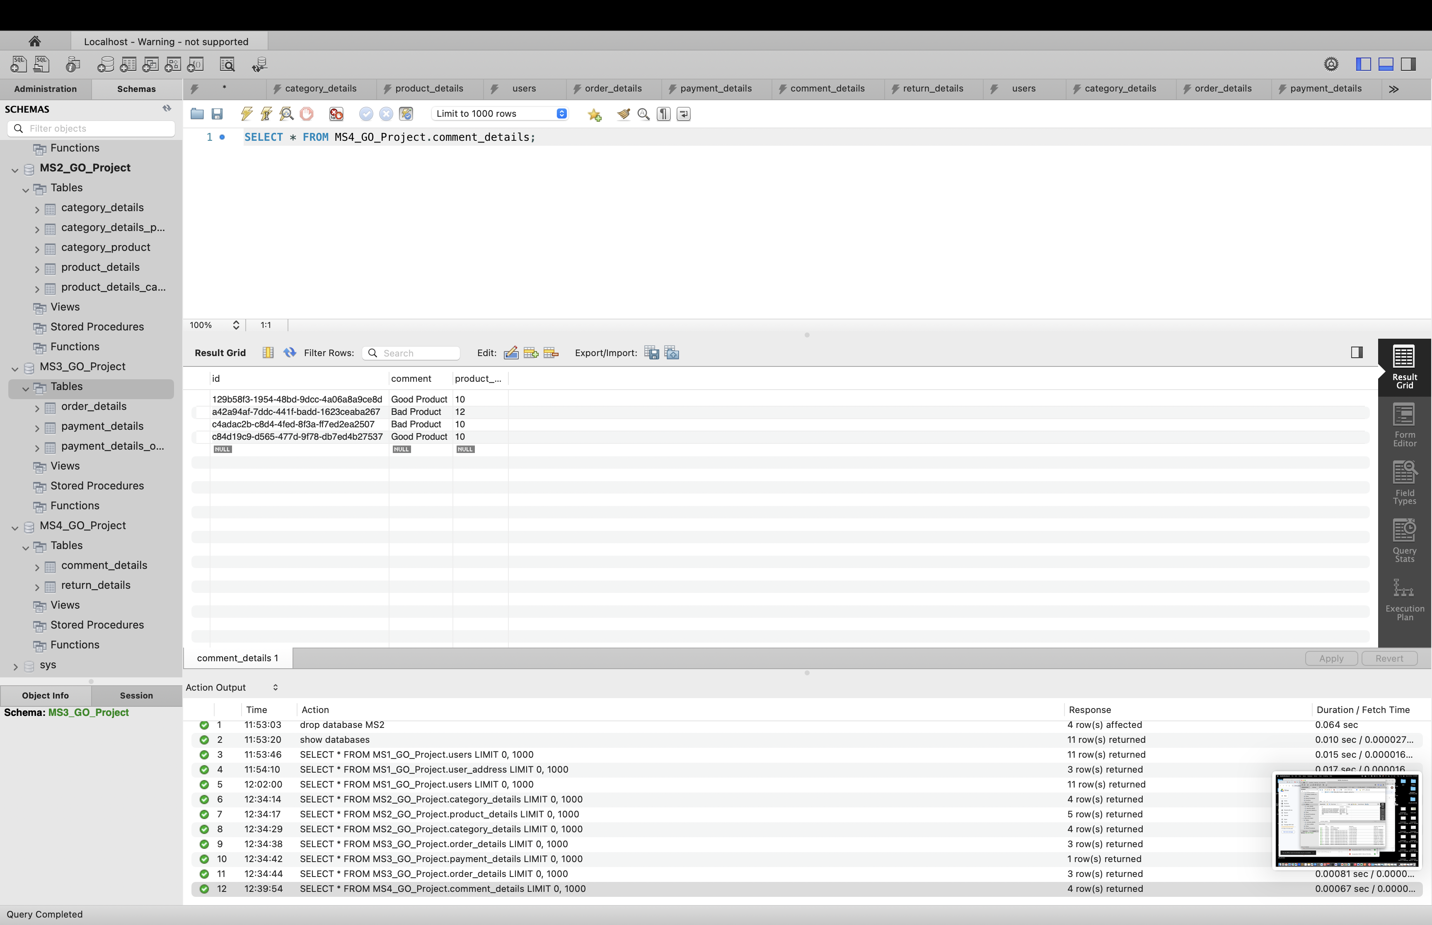
Comment Database

Slide 25
Thank You
z

